Slide 1


Department of
Artificial intelligence and data science
Mini Project – Model Practical
Online Blood Transfusion Application
Team Members:
K.Suriya ganapathi-113121UG08052
N.Sathya narayanan-
113121UG08045
Batch No: 14
Date : 08.06.2024
Guided by,
Mrs.Haritha,B.E.,M.E.,
Assitant professor ,
Department of AIDS.

Slide 2
Abstract
In this project we initialized with the process of online system for the Blood Bank which has done on the basis of latest research works. The quantity of men and women who are in need of blood are growing in huge number day by day. In order to help the people who are in need of blood, our Online Blood Bank can be used correctly for donating and purchasing the blood using a web application. The main concept of this project is to maintain the privacy concerns of the donor. Our web page provides direct communication between the donor and the receiver The receiver cannot contact the donor directly by using their mobile number or address .

Slide 3
Objective
This web application helps in minimizing the search of blood physically when needed . This online platform also deals with the amount of the blood per units, the amount is completely defined by the donor. In addition, when comparing with the existing blood donation application it provides security to the sensitive information of the donor and helps in maintaining the privacy concerns of the donor. It also allows direct communication between the donor and the receiver and provides a secure interaction environment .

Slide 4
Existing System
This project acts as an awfully important role in saving the lifetime of the one in need of blood and which is additionally its main aim. This method is developed so as that users can view the information about registered blood donors like name, address, and other such personal information along with their details of blood group.So as to cross verify and also safety purpose a donor or a receiver must provide their details together with certain documents which can include Aadhar card, pan card. The project consists of a login page where the user should register so only, he/she can view the availability of blood and will also register to donate blood if he/she wishes to. Also, the donor or receiver are presupposed to provide their blood reports and a few other health related documents for security purposes

Slide 5
Disadvantages
Direct access of personal information of donor.
Lack of privacy concern.
Lack of data security.
Retrieval of data takes lot of time.
Percentage of accuracy is less.
Hospital or any other health care institute is used and intermediate.

Slide 6
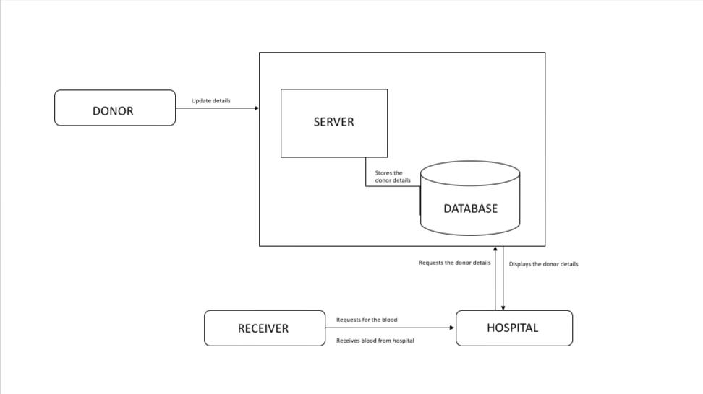
Block diagram of Existing System

Slide 7
Proposed system
Here user must login to create an account either as donor or as a receiver using their gmail id for authentication purpose. The donor has to provide the details like name, location, area name, amount they except form the receiver, blood group, number of units of blood they can provide. The receiver can categorize their needs as type of blood, price range, area. The application provides a communication interface for the interaction of the donor and the receiver.

Slide 8
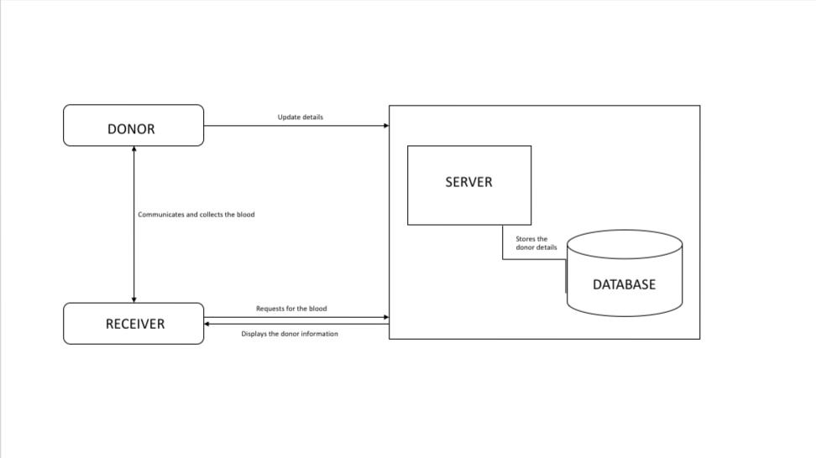
Block diagram of Proposed System

Slide 9
List of modules
Authentication module
The registration module in an online blood bank website is essential for managing user profiles, including donors and recipients. It collects necessary details such as personal and health information for donors, and contact and blood requirements for recipients, ensuring efficient matching and communication between donors and those in need.
Search module
The search module in an online blood bank website enables users to find specific blood types and donor matches quickly. It allows recipients and healthcare providers to search for available donors by blood type, location, and availability, ensuring timely access to needed blood supplies.
Selection module
The selection module in an online blood bank website allows users to choose specific blood donation events or select from available blood units. This facilitates the process of scheduling donations and ensures recipients can reserve the blood type and quantity they need efficiently.
Communication module
The communication module in an online blood bank website facilitates interaction between donors, recipients. It enables sending notifications, reminders, and updates regarding donation schedules, blood requests, and confirmations, ensuring timely and effective coordination.

Slide 10
Comparison of proposed and the existing system
Characteristics
Existing system
Proposed system
Time
Data security
Communication
Intermediate
Time consuming.
Does maintain the security of the data.
Provides contact details for communication.
Hospital or any other healthcare institute is used as intermediate.
Reduce the time complexity.
Maintains data confidentiality.
Provides its own interface for safe and secured communication.
No intermediate the donor communicates with the receiver and they donate their blood according to the receiver’s location and their own comfort.

Slide 11
Advantages
It provides the easy way to search and obtain the required blood. It provides direct interaction and donation of blood.
It allows the donors to display the money they expect or require. This application does not require any intermediate hospital or health care centres. It allows for secure collection and management of donor information, ensuring accuracy, privacy, and compliance with regulatory requirements. Its provides a communication interface for secure interaction between the donors and the receivers

Slide 12
Algorithms
Stable Matching Algorithm (Gale-Shapley Algorithm):
This algorithm is used to find a stable match between two sets of elements based on preferences. It ensures that no pair of elements would prefer each other over their current matches. This can be adapted to match donors and recipients based on criteria like blood type compatibility and urgency.
Search algorithms:
Depth-First Search (DFS):
DFS can be used to search for matches based on specific criteria like blood type compatibility or eligibility. It exhaustively explores one branch of the search tree before backtracking, making it suitable for exhaustive matching.
Hashing:
Hash tables provide constant-time average search complexity, making them efficient for quickly locating donors or recipients based on specific identifiers like donor ID or recipient ID.
Secure Messaging Protocol:
The secure messaging protocol commonly used in online blood bank systems is Transport Layer Security (TLS).TLS ensures the confidentiality, integrity, and authenticity of communications between clients (donors, recipients) and the blood bank system servers. It encrypts data transmitted over the network, preventing eavesdropping and tampering by unauthorized parties.

Slide 13
Implementation methods
Messaging System Integration: The application can integrate a messaging system that allows donors and receivers to communicate directly within the platform. This could be achieved using existing messaging APIs or by developing a custom messaging solution.
User Authentication: Implement robust user authentication mechanisms to verify the identity of both donors and receivers before allowing them to communicate. This can include email verification, phone number verification, or even biometric authentication for added security.
Privacy Protection: Ensure that the messaging system protects the privacy of both donors and receivers. Messages should be encrypted end-to-end to prevent unauthorized access, and personal information should be masked or anonymized to maintain confidentiality.
Matching Algorithm: Develop a matching algorithm that suggests potential matches between donors and receivers based on compatibility factors such as blood type, location, and availability. This algorithm should facilitate efficient communication by presenting relevant matches to users.
Real-time Notifications: Implement real-time notifications to alert users about new messages, potential matches, or updates to their communication status. This ensures that users stay informed and can respond promptly to communication requests.
Mobile Responsiveness: Ensure that the messaging interface is responsive and user-friendly across different devices, including smartphones and tablets. This allows users to communicate conveniently, regardless of their preferred device.

Slide 14
Hardware and software requirements
Hardwares used:
Processor – Quad-core 2.5 GHz or higher.
RAM – 2GB or higher
Storage- 500 Gb solidu state Drive
Network interface – 10GB ethernet
Operating system – Linux or Mac Os or Windows
Hardware – 40 GB or more
Softwares used
Frontend – React Js, Reactstrap components, Bootstrap CSS Backend – Node Js, Express JS Database – AWS RDS

Slide 15
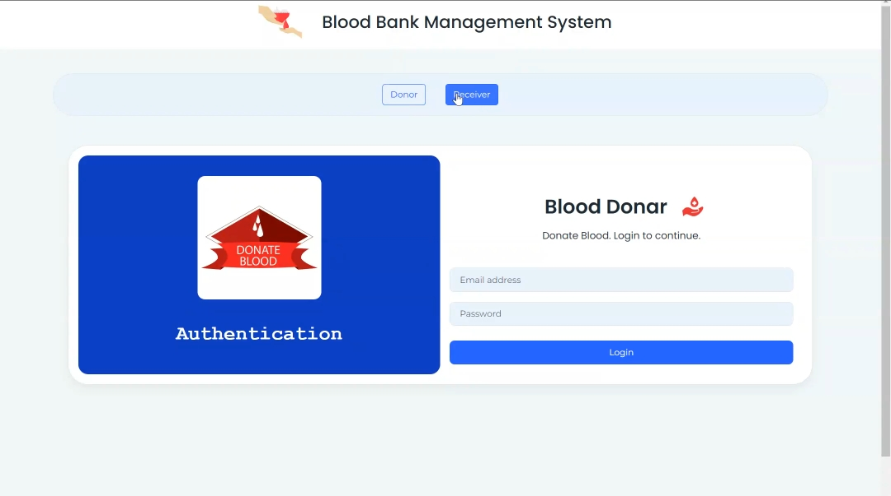
Output

Slide 16
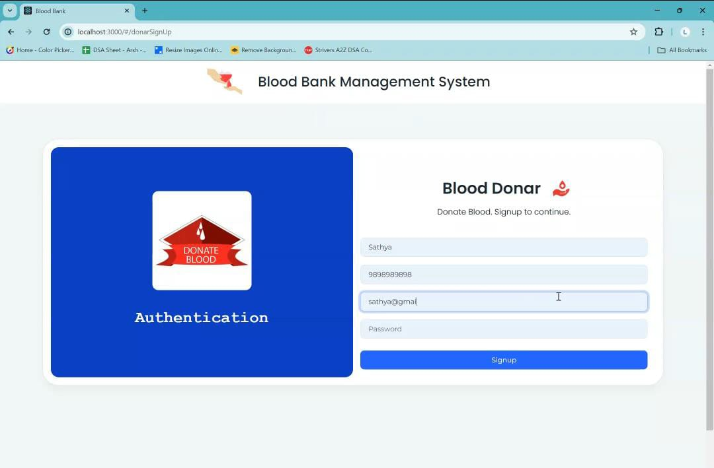

Slide 17
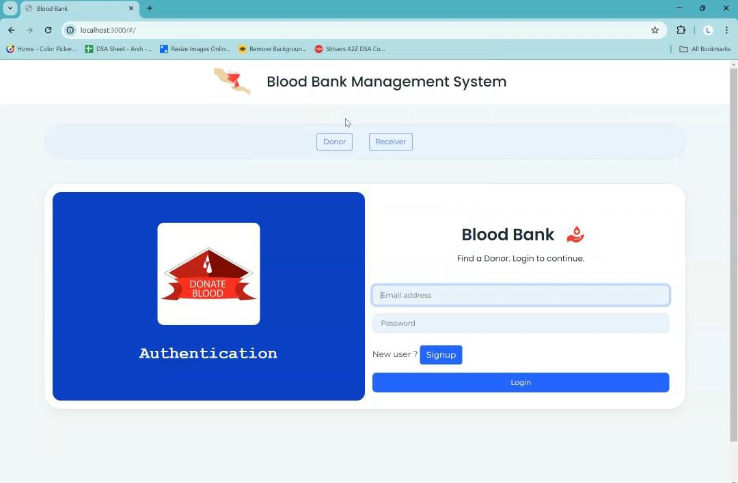

Slide 18
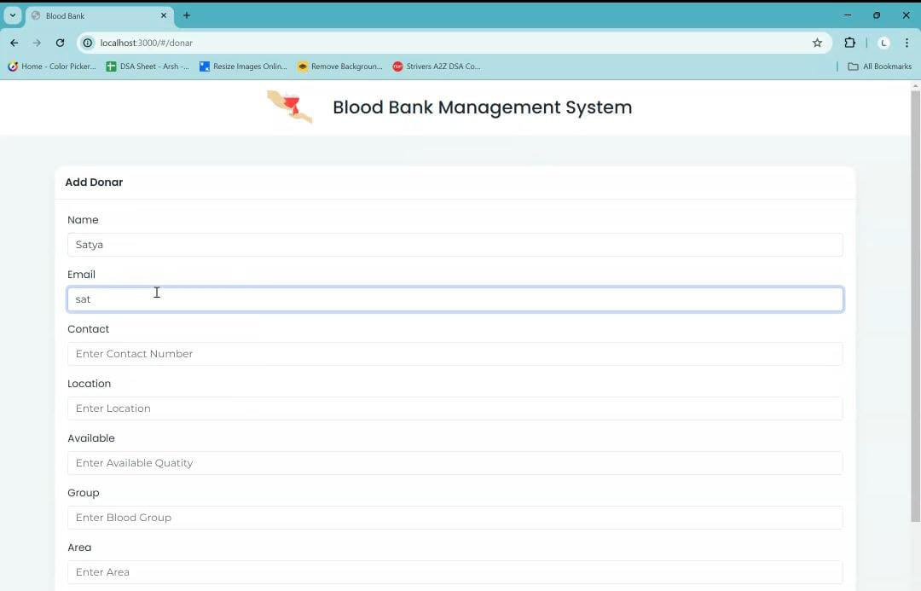

Slide 19
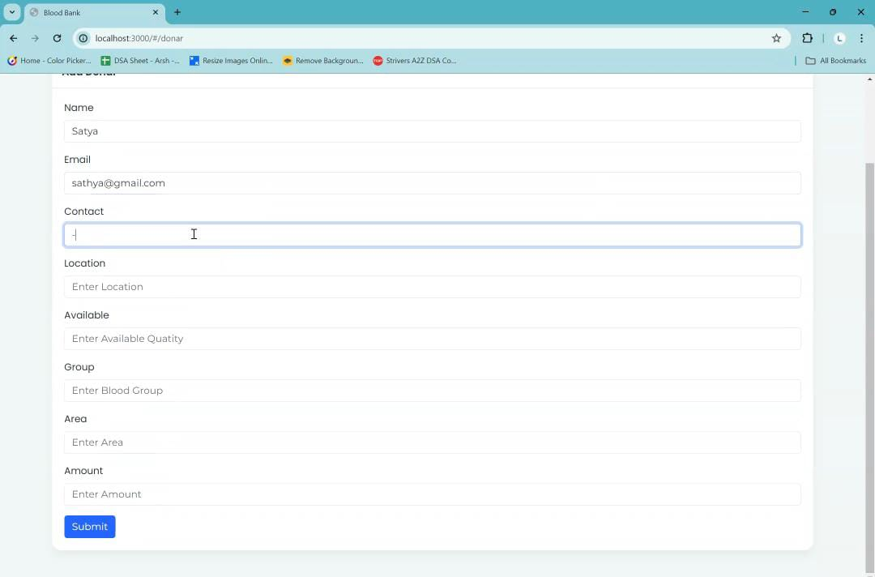

Slide 20
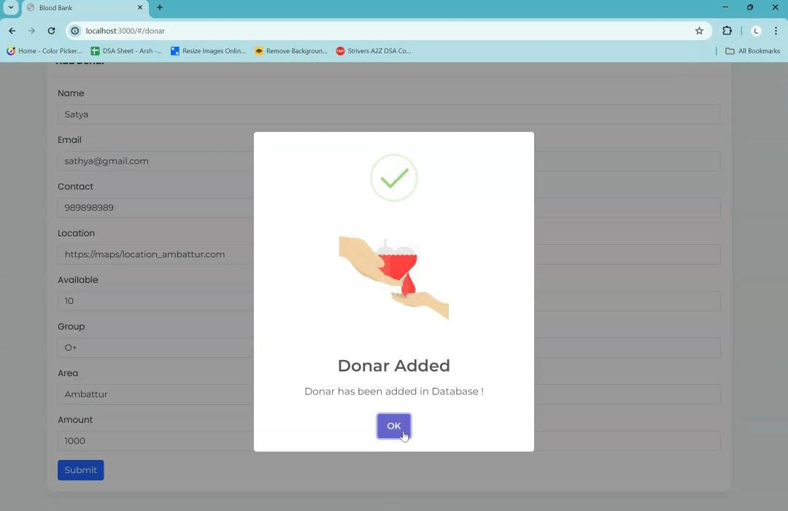

Slide 21
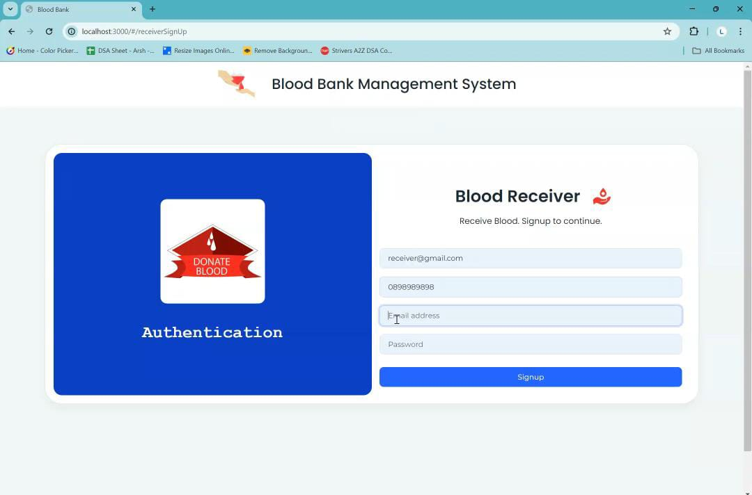

Slide 22
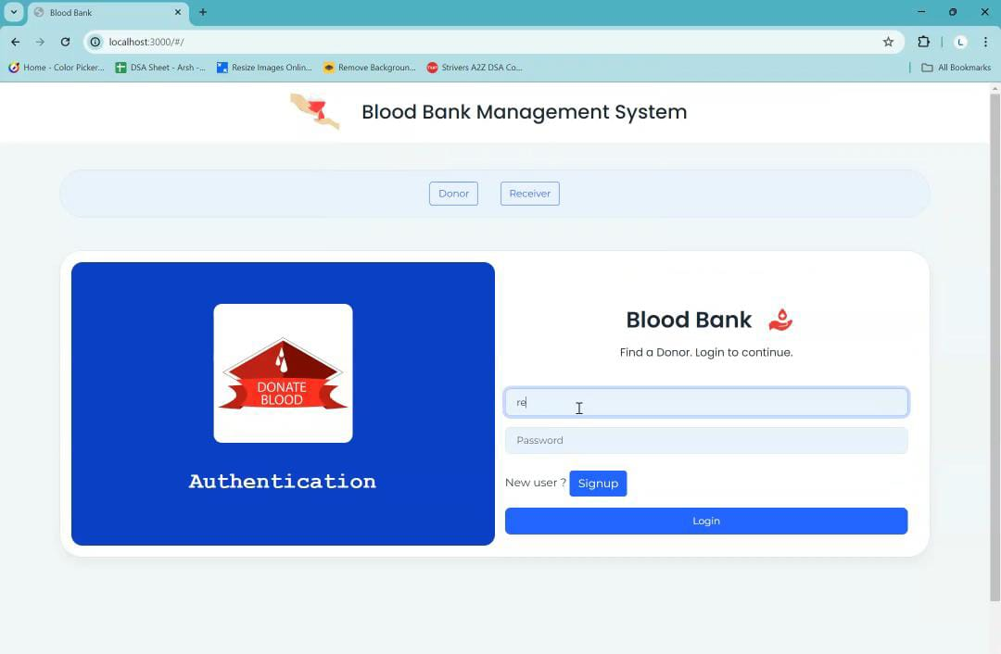

Slide 23
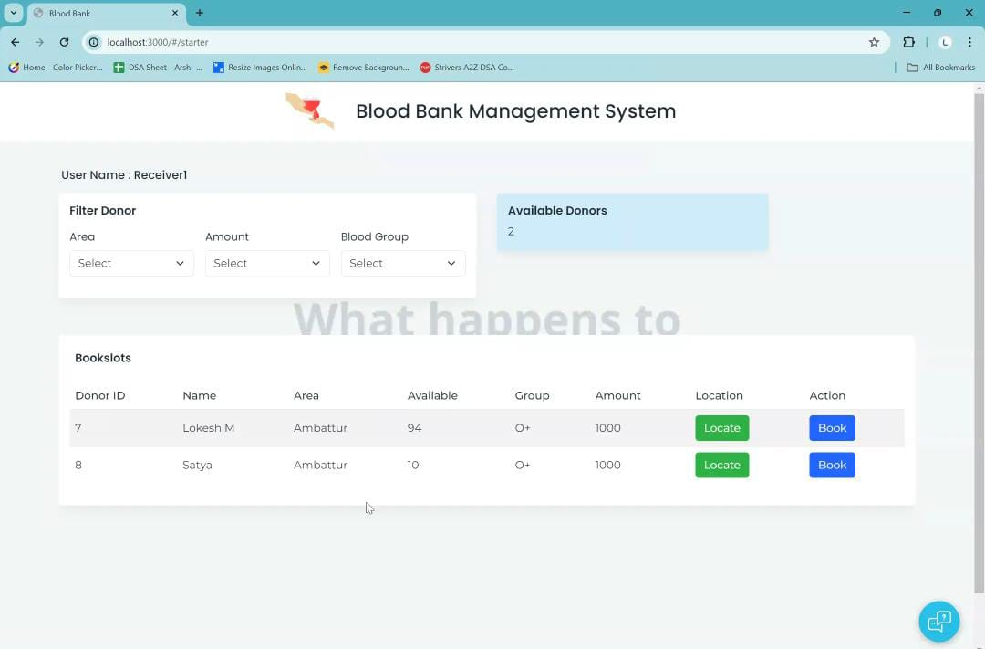

Slide 24
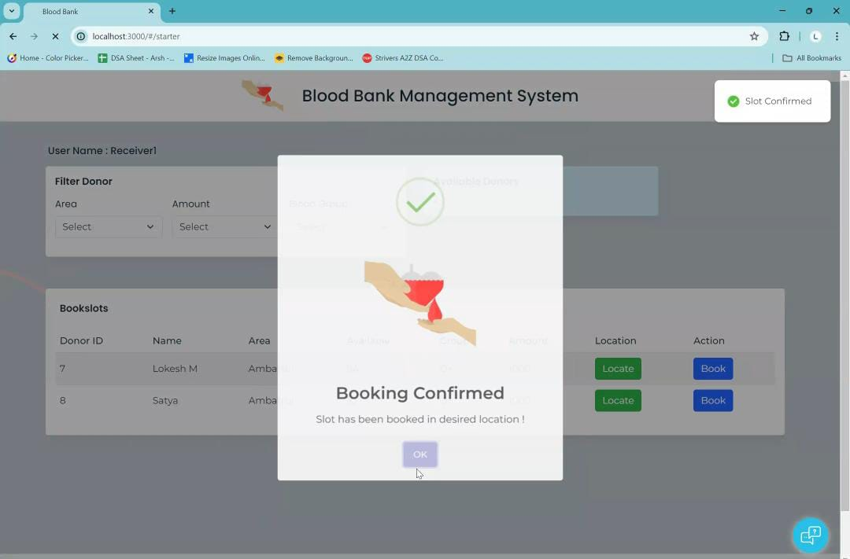

Slide 25
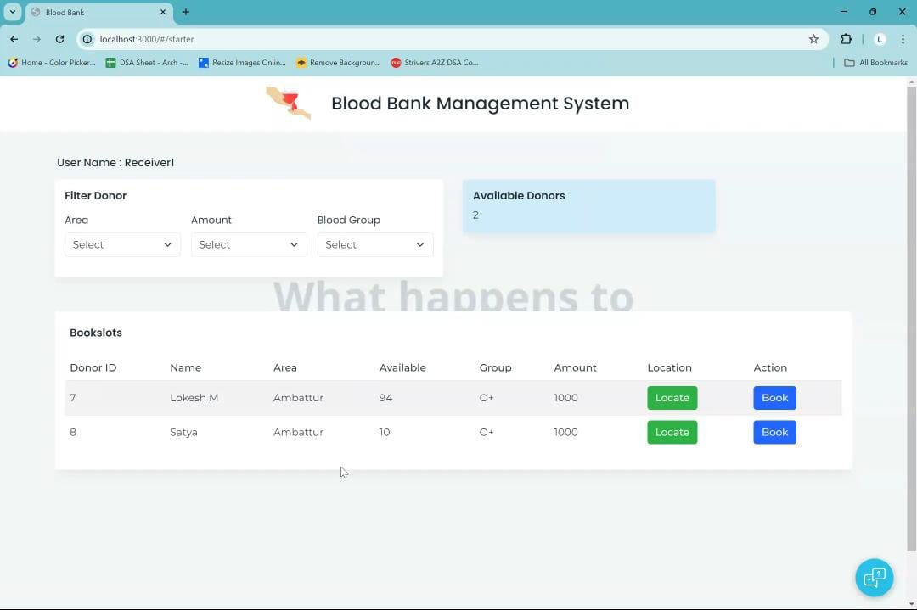

Slide 26
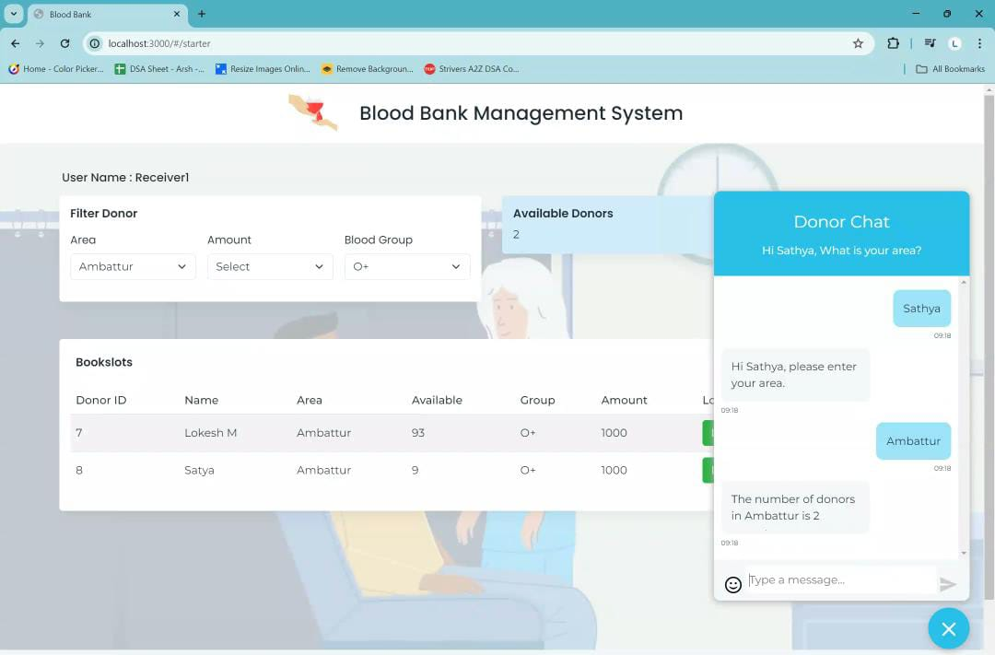

Slide 27
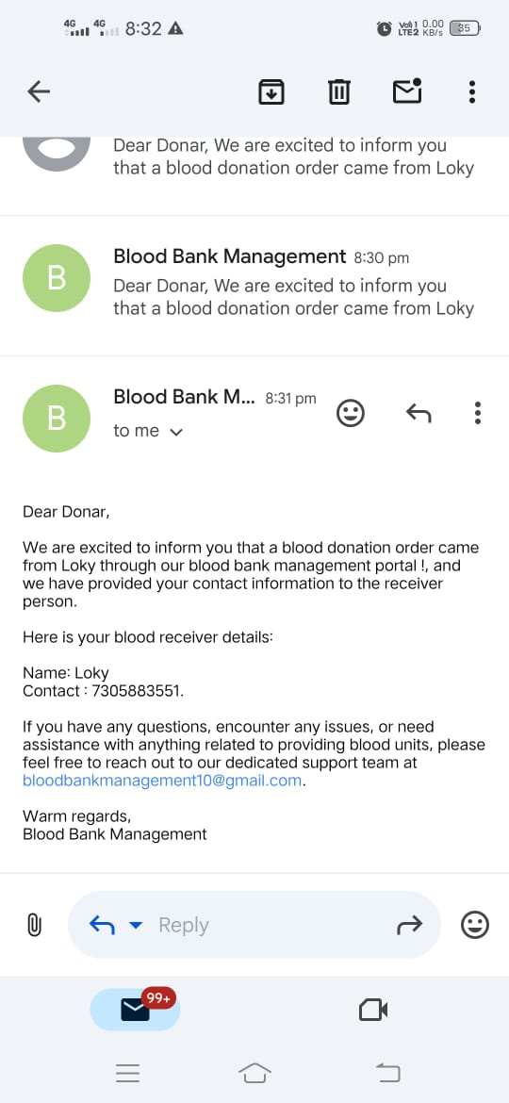

Slide 28
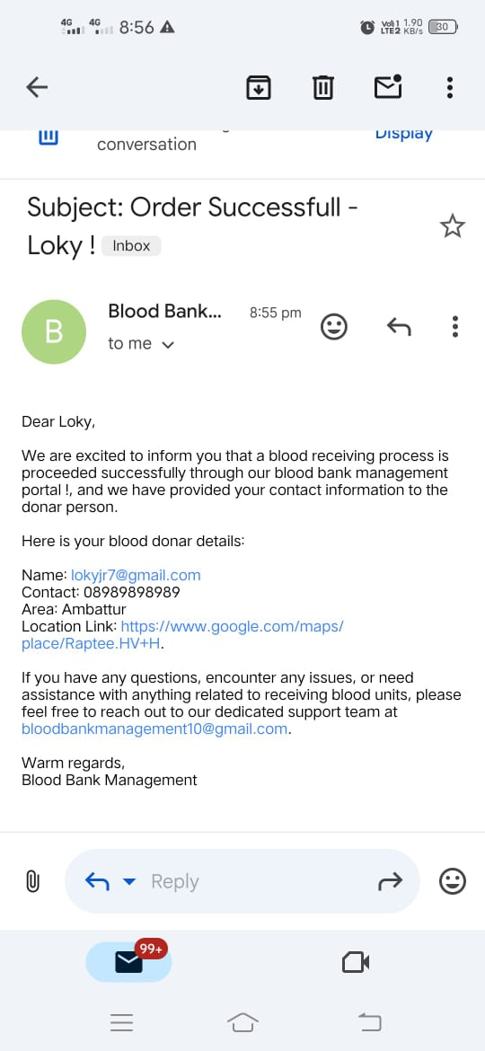

Slide 29
Conclusion
Today the world is become a global village where every thing is online.There are so many web based solutions provided in the market for the comfort of the people.But without blood human being is non living, just by providing the web solution of blood bank management information system is just one more step in order to serve the mankind.An online blood bank website is a vital tool for modern healthcare, facilitating the efficient and secure matching of blood donors with recipients in need. By leveraging sophisticated matching algorithms, secure messaging protocols, and advanced database technologies, these platforms ensure that life-saving blood donations are accurately and swiftly connected to patients.

Slide 30
References
Web-Based Blood Bank System Concepts, by Adnan Faisal, Ammar Hussain (2019).
Online Blood Bank Concepts, by B. Lakshmi Prasanna, C. Kula Deekshith (2019).
Online Blood Bank Management System Concepts, by Aditya S. Iyer, Dr.C. Menaka (2020).
Cloud Based Blood Bank Management System Concepts, by Rasika Bhitale, Jidnesh Koli (2021).

Slide 31
THANK YOU

